Slide 1
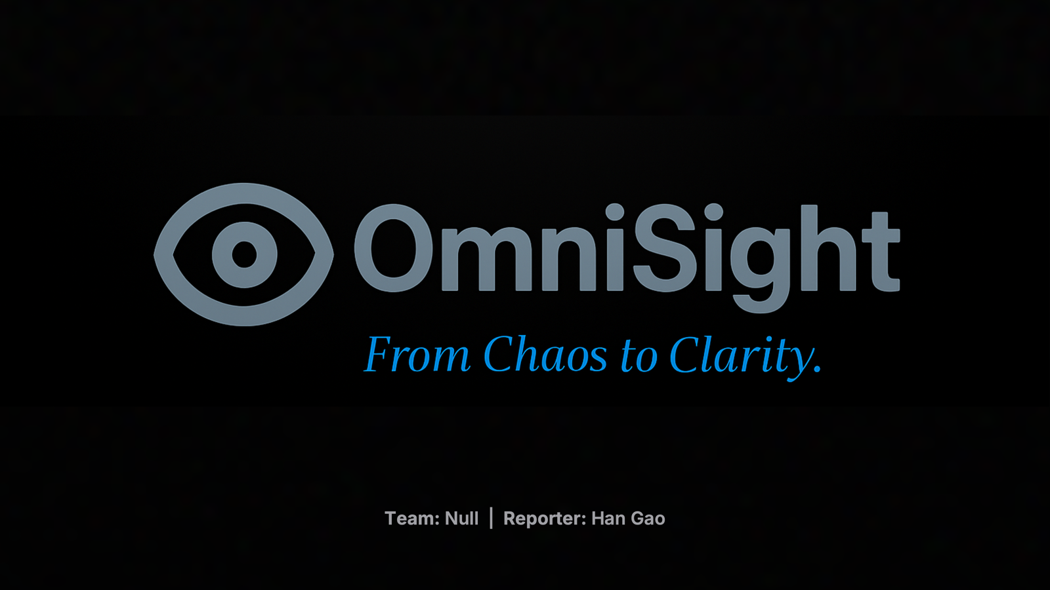

Team: Null | Reporter: Xian Chen
Notes:
陈：
各位老师、同学，大家好。我是 Chenxian。我们是 NULL 小组，本次选择的课题是 Topic 2：Automated Topic Summary Page Generation。今天我们带来的项目名为 OmniSight。
Hello professors and fellow students. My name is chen xian, and we are the NULL team. Our chosen project topic is Topic 2: Automated Topic Summary Page Generation. Today, we are excited to present our system, OmniSight.
在这个信息爆炸的时代，我们的口号是：From Chaos to Clarity。
In an era overwhelmed by information, our slogan is: “From Chaos to Clarity.” OmniSight 的目标是将海量、分散、杂乱的新闻数据，在极短的时间内自动转化为结构化、可追溯、可洞察的核心信息，帮助用户在混乱中迅速抓住重点、获得深度理解。
OmniSight is designed to instantly transform massive, fragmented, and noisy news data into structured, traceable, and insightful key information, enabling users to cut through the noise and grasp the essence with ease.

Slide 2
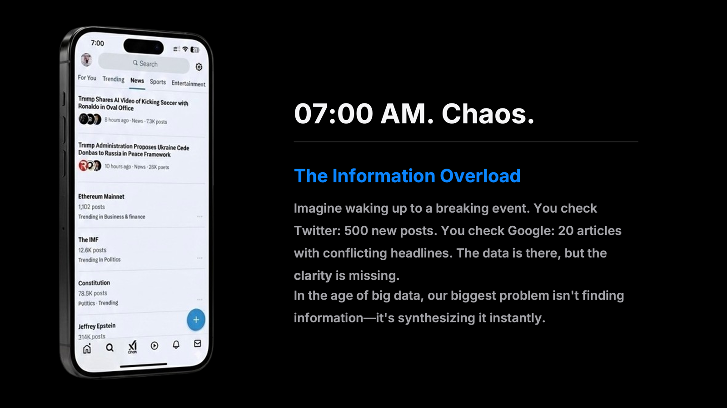

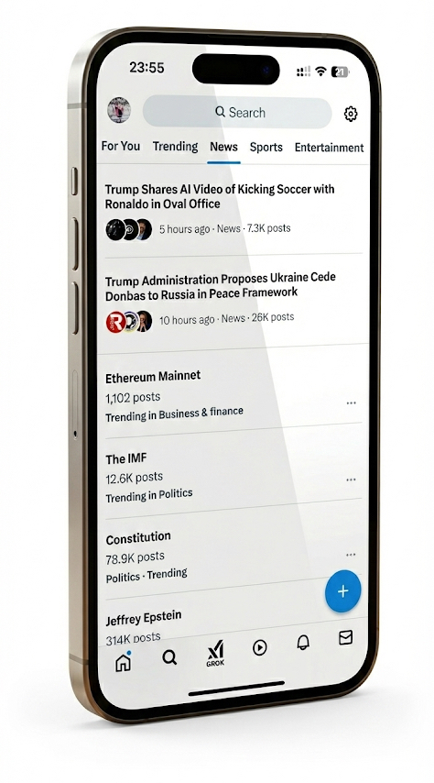

07:00 AM. Chaos.
The Information Overload
Imagine waking up to a breaking event. You check Twitter: 500 new posts. You check Google: 20 articles with conflicting headlines. The data is there, but the clarity is missing.
In the age of big data, our biggest problem isn't finding information—it's synthesizing it instantly.
Notes:
陈：让想象一个典型的场景。 早上 7 点，当我们醒来打开手机，迎接我们的是什么？
Let’s imagine a typical scenario. It’s 7 a.m. You wake up, unlock your phone, and what greets you?
是混乱。
Chaos.
Twitter上可能出现了500 条新的推文，Google News 上关于同一事件的报道可能有50 篇，而且标题往往彼此矛盾。再比如 PPT 中展示的内容，从特朗普相关新闻到以太坊的最新行情，各类信息密集地扑向我们。
There might be 500 new tweets on Twitter, and Google News could be showing 50 articles about the same event—often with headlines that contradict each other. As shown in the slide, information ranges from breaking news about Donald Trump to the latest movements in Ethereum. All this information floods toward us at once.
这一切带来的不是知识，而是过载。
What we experience is not insight, but overload.
正如我们常说的：“The data is there, but the clarity is missing.”（数据在那里，但清晰度缺失了。）
在大数据时代，我们最大的问题已经不再是“能不能获取信息”，而是如何在瞬间对海量信息进行整合与提炼（Synthesize）。
As the saying goes, “The data is there, but the clarity is missing.”
In the era of big data, our biggest challenge is no longer accessing information, but how to synthesize massive amounts of information instantly and meaningfully.

Slide 3

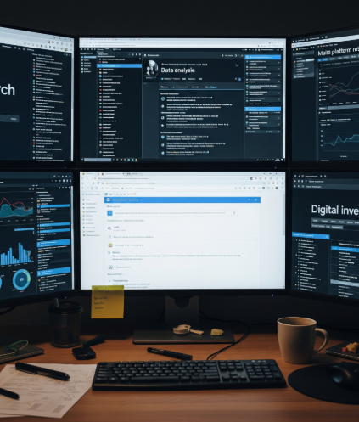




Why OmniSight?
For Decision Makers
Researchers, analysts, and users who need to grasp complex situations in seconds, not hours.
The Friction
Manual compilation is slow. News fragmentation across platforms makes it impossible to see the full picture.
Notes:
姚：
要回答这个问题，我们必须回到它所提供的核心价值。
Now let’s consider a fundamental question: Why do we need OmniSight?
To answer this, we need to return to the core value it provides.
我们的核心用户，是那些身处高信息密度环境中的决策者——例如被海量学术文献淹没的研究人员、需要追踪实时市场动态的分析师等等。在信息筛选上浪费时间，就意味着错失关键的决策窗口。
Our primary users are decision-makers operating in high-information-density environments—researchers overwhelmed by academic literature, analysts tracking real-time market movements, and many others. Time wasted on filtering information means missing critical decision-making windows.
这些用户普遍面临两个主要痛点：
These users face two major pain points:
手动整理效率极低。 想象一下，你需要花几个小时在不同网站之间复制、比对、汇总数据，却发现内容已经过时——这不仅慢、枯燥，还极其容易出错。 Extremely low efficiency in manual data compilation.
Imagine spending hours copying, comparing, and consolidating information from different websites, only to realize the data is already outdated—slow, tedious, and highly error-prone.
此外，信息高度碎片化。 各个平台往往只呈现零散的新闻片段，在不同来源之间频繁切换会造成信息断层，难以把握事件的整体脉络，最终导致理解偏差甚至错误决策。
moreover, Severe information fragmentation.
Most platforms provide only isolated pieces of news. Constantly switching between sources creates information gaps, making it difficult to grasp the full narrative and often leading to misinterpretation and poor decisions.

Slide 4
"Three search engines. One intelligent brain. Infinite clarity."
The OmniSight Vision
Notes:
姚：简单说一下我们的项目特点，用Google、baidu、Bing应检索得到更多信息，结合大语言的模型能力整合信息，清晰结构化的内容呈现给用户
Let me briefly describe the characteristics of our project. By using Google, Baidu, and Bing, we can retrieve more information and integrate it with the modeling capabilities of large language model to present clear and structured content to users.

Slide 5

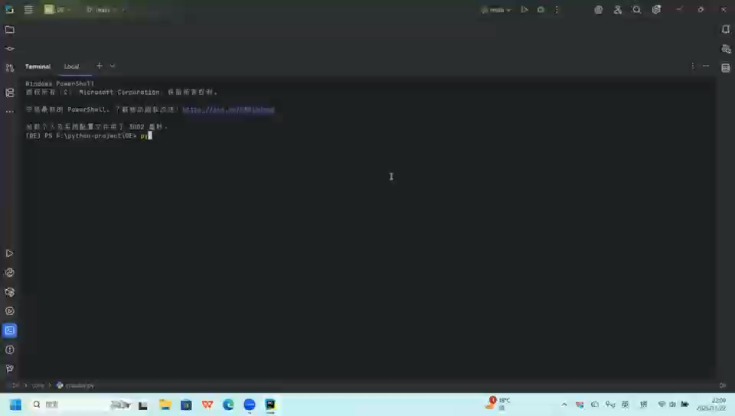
Notes:
陈：
接下来我将演示我们的系统，
●Next, I will demonstrate our system.
●首先看到的是基于 PyQt6 构建的可视化客户端。界面简洁直观，
●First, you can see the visual client built with PyQt6. The interface is clean and intuitive.
●我们先以‘自动驾驶’为关键词来演示一下，可以自定义抓取数量和时间范围，这里我们选择抓取5篇文章，时间限定为‘过去一个月’，然后点击‘开始分析’，
●We’ll start with the keyword “autonomous driving” for the first demo. You can customize the number of articles to fetch and the time range. Here, we choose to fetch 5 articles and set the time filter to “past month”. Then we click “Start Analysis.”
●后台首先启动多源搜索引擎，智能组合Google、百度和Bing的结果，解决了单一引擎覆盖不足的问题。
●In the backend, the system launches a multi-source search engine that intelligently combines results from Google, Baidu, and Bing solving the problem of limited coverage from using a single engine.
●现在进入核心处理阶段。系统会自动在‘静态爬虫’和‘动态Selenium爬虫’间切换以应对反爬。在基于 Map-Reduce 架构获取信息后调用大语言模型进行深度聚合分析。
●Now we enter the core processing stage. The system automatically switches between a static crawler and a dynamic Selenium crawler to handle anti-scraping measures. After gathering information via a Map-Reduce architecture, it calls a large language model for deep aggregated analysis.
●分析完成，系统自动生成了一份深色主题的 HTML 报告。首先看到的是‘摘要’。"
●Once the analysis is complete, the system automatically generates a dark-themed HTML report. The first section is the “Summary,”
●往下看，系统提取了‘关键主题’和‘涉及实体’，比如文远知行、小马智行等。下方是自动生成的‘事件时间线’。"
●Scrolling down, the system extracts “Key Topics” and “Entities Involved,” such as WeRide and Pony.ai. Below that is the automatically generated “Event Timeline,” .
●底部是可点击的相关网站的链接。
●At the bottom are links to relevant websites that are clickable.
●我们再测试一个科技圈的热点。输入‘苹果发布会’，这次我们稍微增加一点文章数量。
●Let’s test another popular tech topic. We enter “Apple wwdc 2025” and this time increase the number of articles slightly.
无论是国内新闻还是国际科技资讯，系统都能稳定抓取。对于需要 JavaScript 渲染的动态网页，我们的动态爬虫模块也能轻松应对
●the system reliably fetches both domestic and international tech news. and For dynamic webpages requiring JavaScript rendering, our dynamic crawler module handles them easily.
●报告生成了。针对‘苹果发布会’，AI 准确提取了 、airpords pro3等关键产品信息，并按时间顺序列出了发布预告和正式发布的时间节点。这就是我们OmniSight的系统
●The report is generated. Regarding the “Apple wwdc2025,” our system accurately extracts key information like the visonos, and lists related timeline.
That is our omnisight!

Slide 6
System Architecture
Search
Crawl
Clean
Analyze
Report
Multi-Engine Query
Hybrid Fetching
Fuzzy Deduplication
Map-Reduce LLM
OmniSight Report
Notes:
姚: 然后让我来介绍我们系统的结构。我们的系统由五部分组成一个工作流，也对应着一个数据管道。
Then let me introduce the architecture of our system. Our system consists of five parts forming a workflow, which also corresponds to a data pipeline.
首先，我们利用多引擎查询信息；
随后通过混合模式爬虫获取内容；
接着对数据进行清洗与模糊去重；
再结合大语言模型的能力对信息进行组织与结构化；
最后，将结果以清晰、直观的可视化报告呈现给用户。
First, we gather information through multi-engine search.
Next, we extract content using our hybrid crawling approach.
Then we clean the data and apply fuzz deduplication.
After that, we use large language models to organize and structure the information.
Finally, we present the results to the user in a clear and visually intuitive report.

Slide 7



1. Intelligent Search
Multi-Source Ingestion
OmniSight doesn't rely on a single source.
Benefit: Elimination of source bias and maximum event coverage.
Notes:
姚:
OmniSight结合了多个搜索引擎进行全面搜索，而不是仅仅依赖于单一的信息来源。
OmniSight combines multiple search engines for comprehensive search, rather than relying solely on a single source of information.
该系统的策略是优先使用谷歌，如果数量不够，则使用百度进行补充。如果还不够，再使用Bing进行补充。
The system's strategy is to prioritize using Google, and if the quantity is not enough, use Baidu to supplement. If it's not enough, use Bing to supplement.
在搜索过程中自动删除重复项，以确保链接唯一。这种策略可以消除源偏见，最大限度地覆盖事件。
Automatically remove duplicates during the search process to ensure unique links. This strategy can eliminate source bias and maximize coverage of events.

Slide 8





2. Hybrid Crawling
Static Mode
Dynamic Mode
Uses Newspaper3k. Ultra-fast. Handles most of standard news sites. Low resource consumption.
Uses Selenium. Automatically activates when static crawling fails. Renders JS-heavy sites to capture elusive data.
Notes:
陈：获取到搜索返回的链接后，系统便进入爬取阶段。在这一部分，我们设计了 “混合爬虫（Hybrid Crawling）” 机制：
After retrieving the search result links, our system enters the crawling stage.For this part, we designed a Hybrid Crawling mechanism:
首先是 Static Mode（静态模式）：我们使用 Newspaper3k，它的优势是速度极快、资源占用极低，能够处理绝大多数标准新闻网站。
We begin with Static Mode, powered by Newspaper3k. It is extremely fast, lightweight, and capable of handling the majority of standard news websites.
但如果遇到大量依赖 JavaScript 渲染的页面怎么办？
But what happens when we encounter pages that rely heavily on JavaScript rendering?
系统会自动切换到 Dynamic Mode（动态模式）。我们会启动一个无头浏览器（Selenium），模拟真实用户的浏览行为，对页面进行完整渲染，从而捕获静态爬虫无法获取的内容。
In that case, the system automatically switches to Dynamic Mode. A headless browser (Selenium) is launched to simulate real user interactions and fully render the page, allowing us to capture data that static crawlers cannot reach.
这一组合策略保证了我们系统的高鲁棒性与广泛适用性。
This hybrid strategy ensures strong robustness and broad compatibility across diverse web environments.

Slide 9

3. Smart Deduplication
Signal to Noise Ratio
News outlets often copy-paste content. We use the Levenshtein Distance algorithm to compare article titles.
Similarity Threshold
If Article A is >85% similar to Article B, OmniSight discards the duplicate, ensuring the LLM only reads unique, high-value content.
Notes:
姚: 在爬取网站后，我们进入去重阶段
After crawling, we enter the deduplication stage.
新闻媒体经常复制粘贴内容。我们使用Levenshtein距离算法来比较文章标题。
News outlets often copy-paste content. So we use the Levenshtein Distance algorithm to compare article titles.
Levenshtein 距离，也称为编辑距离，是一种用于衡量两个序列差异的字符串度量。它定义为将一个单词转换为另一个单词所需的最少单字符编辑操作次数（插入、删除或替换）。
The Levenshtein Distance, also known as Edit Distance, is a string metric for measuring the difference between two sequences. It is defined as the minimum number of single-character edits (insertions, deletions, or substitutions) required to change one word into the other.
通过这种算法，我们可以对文章标题进行模糊匹配。如果文章A与文章B的相似度>85%，OmniSight会丢弃重复内容，确保LLM只读取唯一的高价值内容。
Through this algorithm, we can perform fuzzy matching on article titles. If the similarity between article A and article B is greater than 85%, OmniSight discards the duplicate, ensuring the LLM only reads unique, high-value content.

Slide 10


4. Map-Reduce Analysis
Map Phase
Reduce Phase
Output
Timeline
Key Entities
Key Sub-themes
Summary
Summarize
Aggregate
Notes:
姚: 在分析阶段，我们参考了map-reduce架构思想来分析整合文章内容。
In the analysis stage, we referred to the idea of map-reduce architecture to analyze and integrate the content of the article.
在Map阶段，我们用LLM分别总结每篇文章为100字的摘要以及提取关键点。
In the Map phase, we use LLM to summarize each article into a 100 word abstract and extract key points.
在Reduce阶段，我们用LLM对所有摘要进行总结。
In the Reduce phase, we use LLM to summarize all abstracts.
最后得到四类输出：事件的时间线，参与的关键实体，事件背后的主要子主题，加强的总结。然后将这些输出生成一份HTML报告。
Finally, four types of outputs are obtained: timeline of the event, key entities involved, main sub-themes behind the event, and strengthened summary. Then generate an HTML report from these outputs.

Slide 11




Future Horizons
Knowledge Graphs
Real-Time Streaming
Moving beyond text summaries to visual node-link diagrams (Neo4j) to show relationships between entities.
Replacing batch processing with WebSocket-based real-time feeds for instant breaking news updates.
Notes:
陈:OmniSight 目前已经是一款十分强大的工具，但我们的探索远未止步。
OmniSight is already a powerful tool, but our journey has only just begun.
未来，我们计划引入 知识图谱（Knowledge Graphs）。通过使用 Neo4j，我们能够将文本摘要转化为可视化的节点关系图，更直观地呈现新闻事件中各实体之间隐藏而复杂的联系。
In the future, we plan to integrate knowledge graphs. By leveraging Neo4j, we can transform textual summaries into visualized networks of entities, revealing the hidden relationships within complex news ecosystems.
此外，我们还希望将当前的批处理模式升级为 实时流处理（Real-Time Streaming）。借助 WebSocket 技术，我们可以对突发新闻进行毫秒级的监控和动态更新，就像我们日常查看股票行情一样即时、连续。
We also aim to upgrade our current batch-processing workflow into real-time streaming. With WebSocket technology, OmniSight would be able to monitor and update breaking news at millisecond-level latency，you know just like watching live stock market data.

Slide 12

Q & A
Thank you.
github.com/SHANECHEN0722/news_seacher
Notes:
陈：我们坚信：从混乱到清晰，只需要一个足够智能的工具。
We truly believe that turning chaos into clarity only requires one intelligent tool.
目前，我们的代码已经全部开源在 GitHub 上，欢迎大家扫描二维码了解与关注。
Our code is fully open-sourced on GitHub, and we welcome everyone to scan the QR code and check it out.
谢谢各位的聆听！
Thank you for your attention

